Slide 1

视频技术

Slide 2

目录
数字视频介绍
2. 数字图像及视频处理
3. 视频标准及编解码
4. Q&A

Slide 3

数字视频介绍

Slide 4
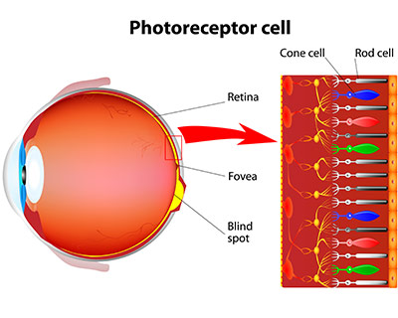
Retina - Cone Cell
The retina has approximately 6 million cones.
Red-sensing cones (60 percent)
Green-sensing cones (30 percent) and
Blue-sensing cones (10 percent)
Notes:
demo: transform.html

Slide 5
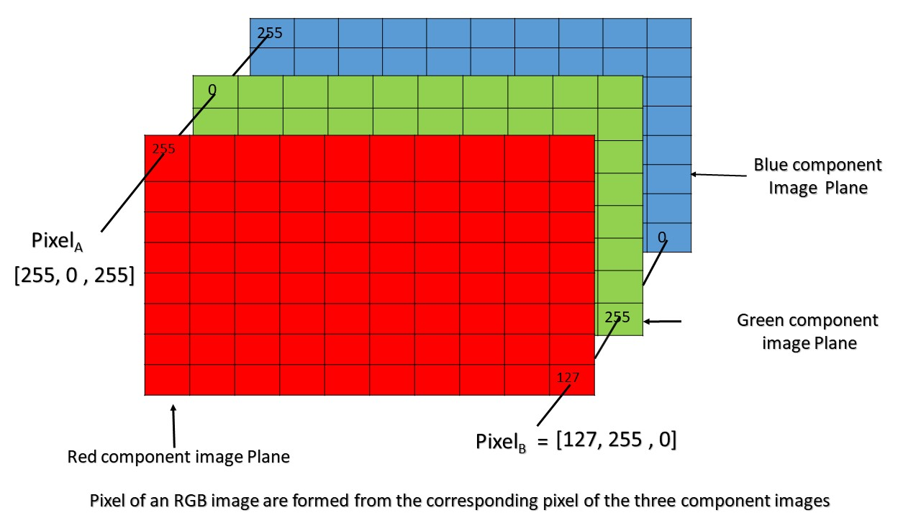
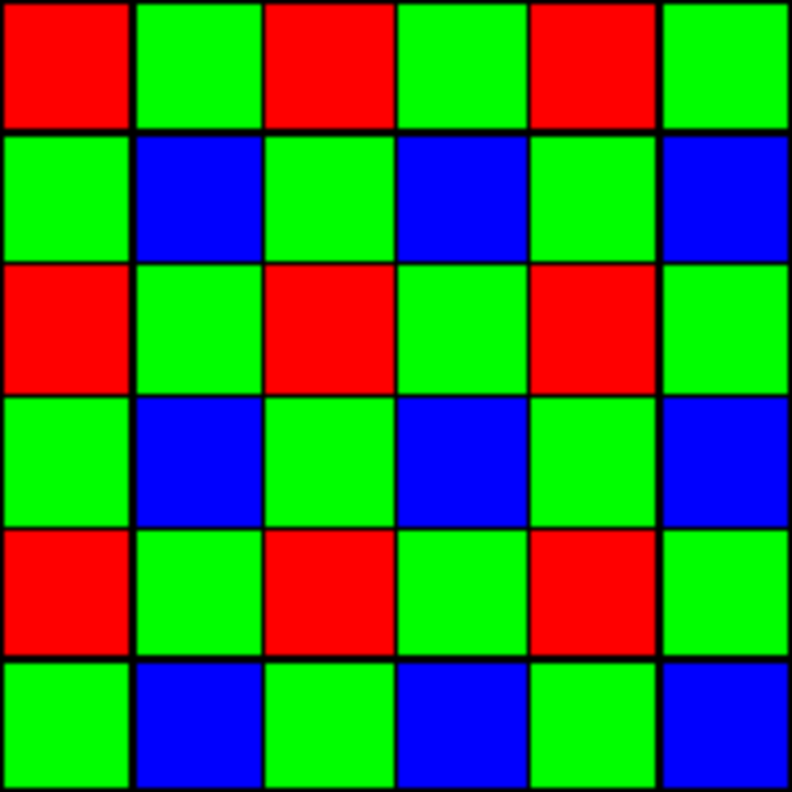
RGB - Red, Green and Blue
Sensor
RGB Matrices
Notes:
demo: transform.html

Slide 6
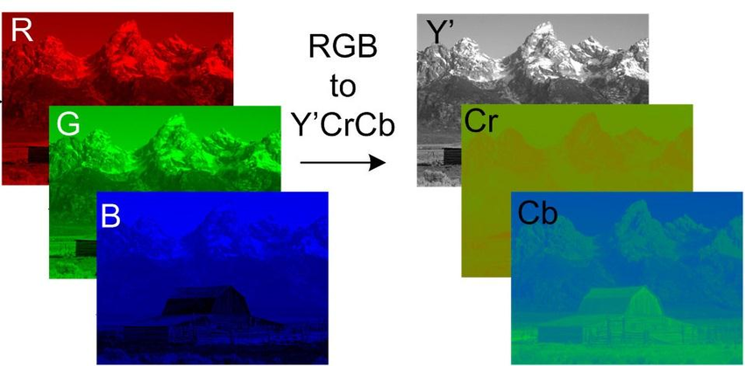
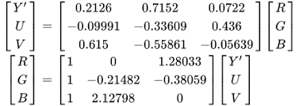
YUV - Luma & Chroma
Notes:
demo: transform.html

Slide 7
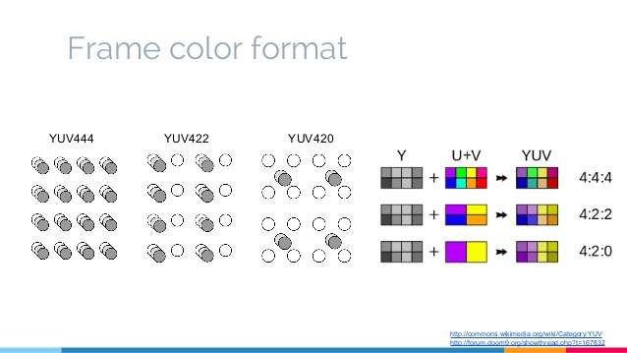
Chroma Subsampling - YUV420
Notes:
demo: transform.html

Slide 8
Why Using Digital Video
Reliable
Copy
Storage
Streaming
Encryption
Applications
Digital TV
Digital Cinema
Video Streaming over the Internet
点播/直播/实时通信，长视频/短视频，PGC/UGC
Computer Vision and Scene/Activity Understanding
Notes:
demo: transform.html

Slide 9
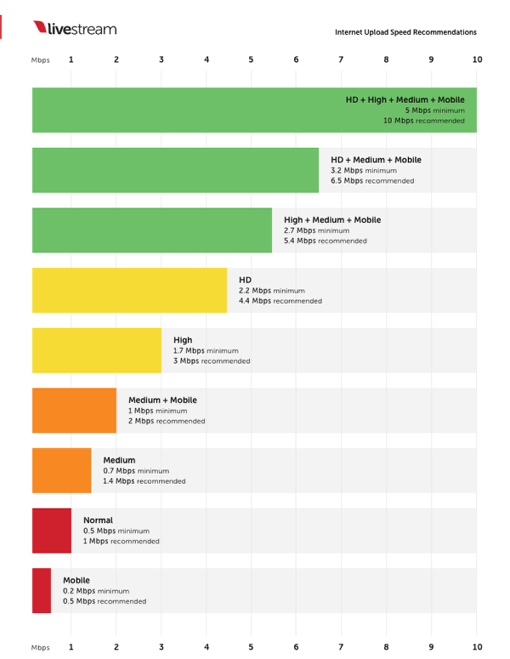
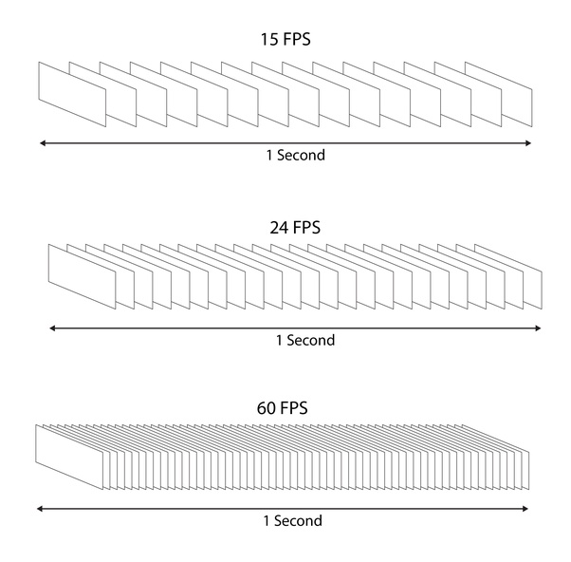
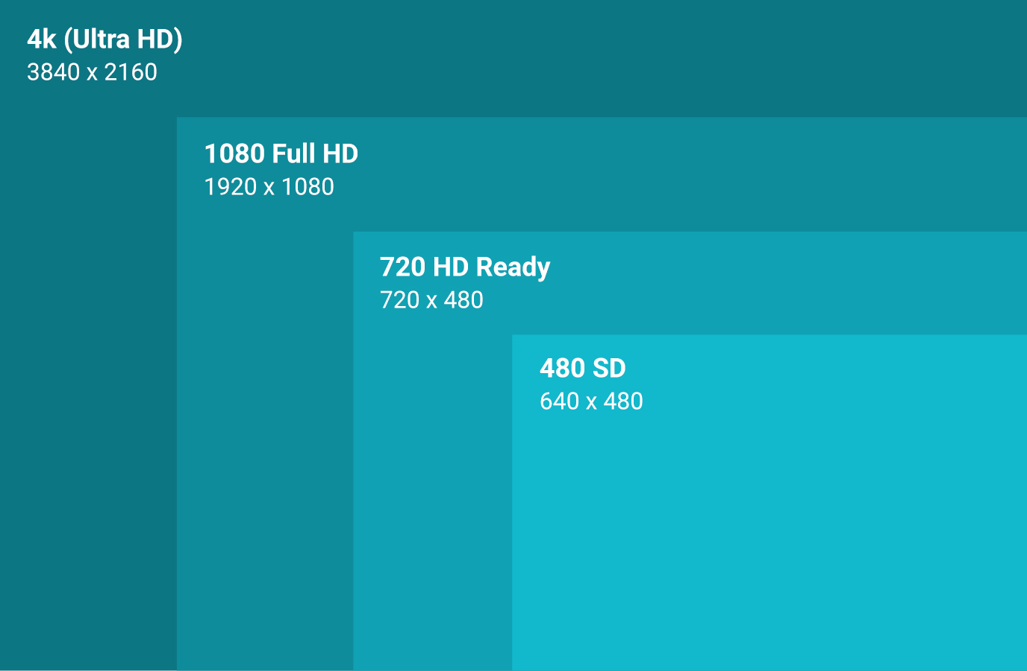
Video Properties - 3 Primaries
Resolution
Frame Rate
Bit Rate
Notes:
demo: transform.html

Slide 10
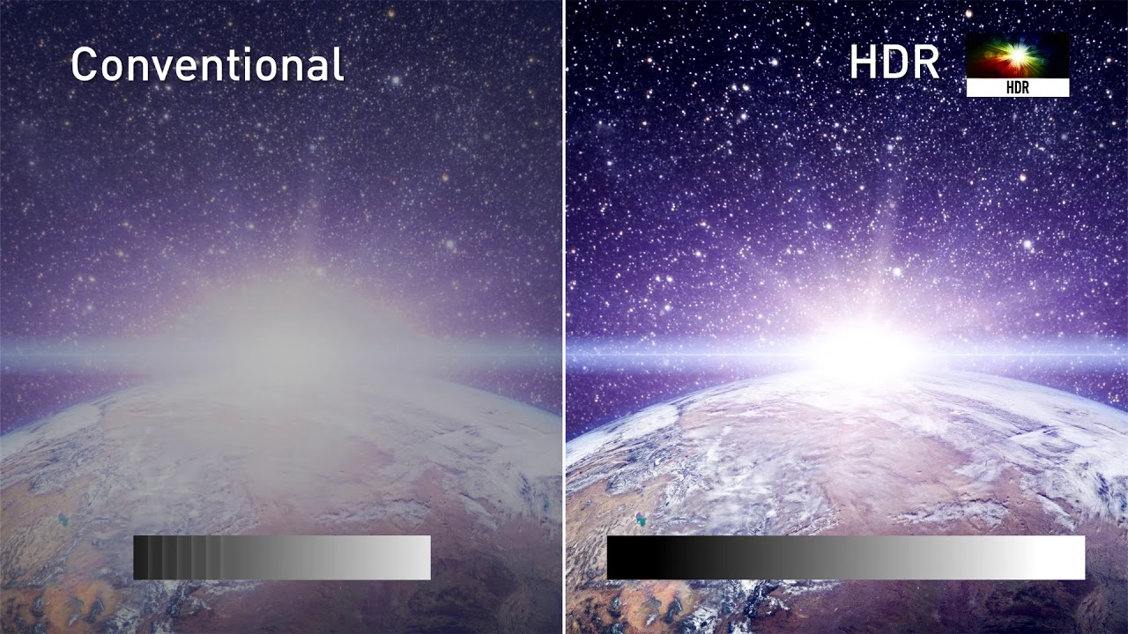
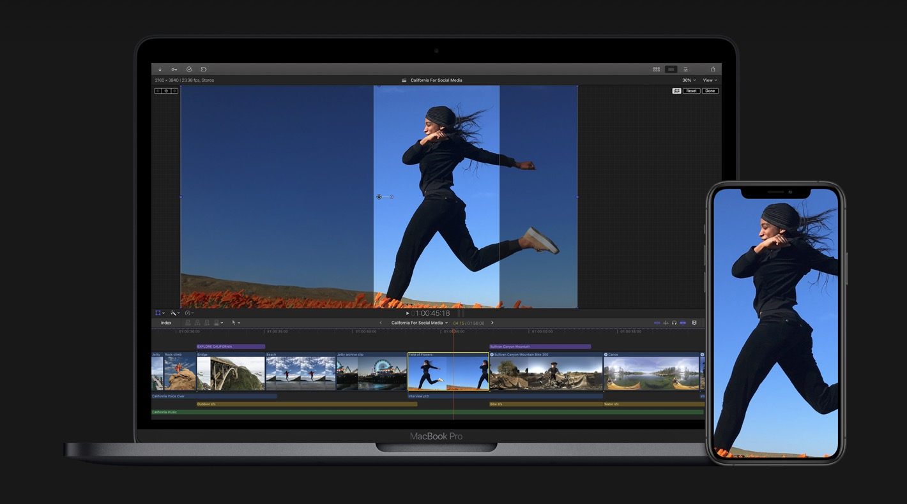
Video Properties
SDR vs HDR (10bit)
ProRes 422 (Final Cut Pro)
Notes:
demo: transform.html

Slide 11
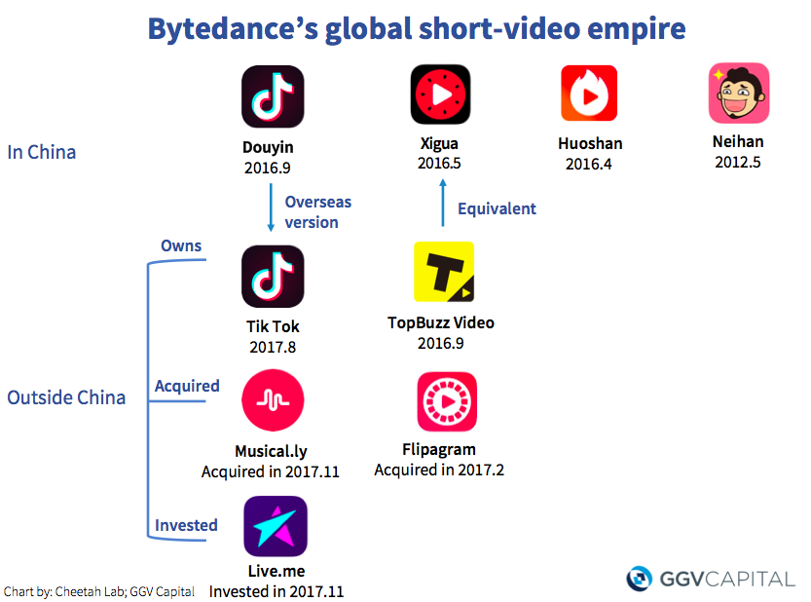
Video - Inspire Creativity, Enrich Life
Notes:
demo: transform.html

Slide 12
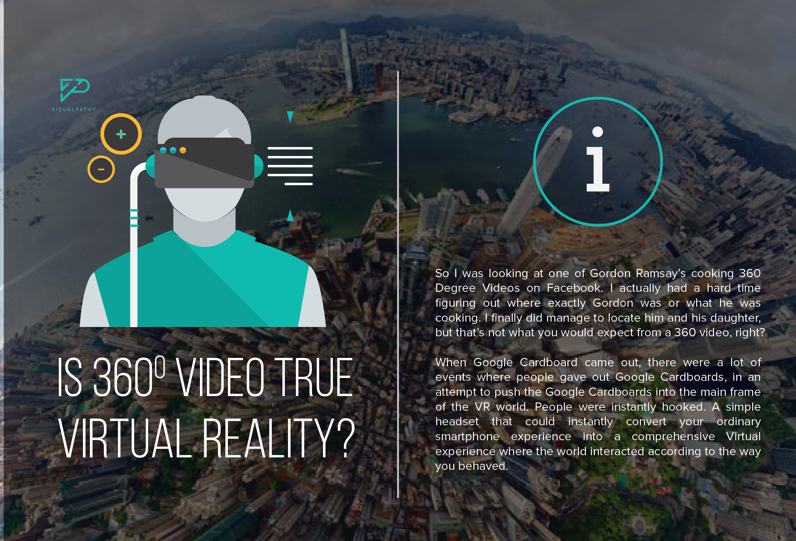
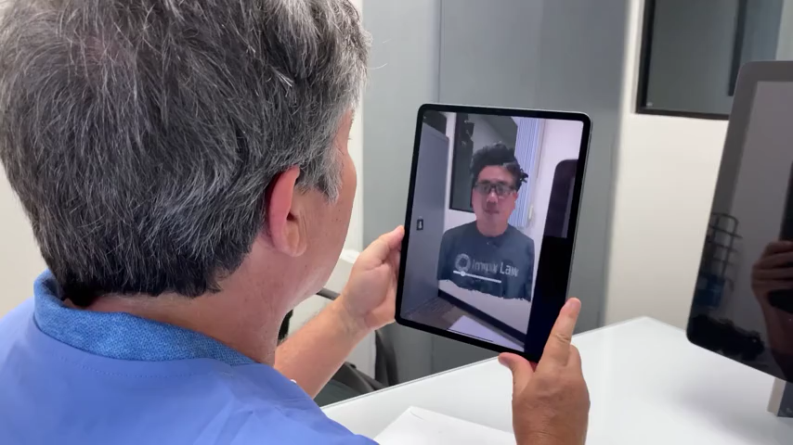
Video Fun
360 video
Volumetric Telehealth Video
Notes:
demo: transform.html

Slide 13
数字图像及视频处理

Slide 14
What is Image Processing
manipulating or performing operations on images to achieve a certain effect
getting some information out of an image with a computer
Notes:
demo: transform.html

Slide 15
Environment Setup
OpenCV for Python
Read, convert, and show an image
import cv2
from matplotlib import pyplot as plt
# read an image
src = cv2.imread("src_blur.jpg")
# convert an image
img = cv2.cvtColor(src, cv2.COLOR_BGR2RGB)
# show an image
plt.imshow(img)
plt.show()
https://codewords.recurse.com/issues/six/image-processing-101
Notes:
demo: transform.html

Slide 16
Environment Setup
Plan A - Docker
mkdir -p /tmp/playground
docker run -p 127.0.0.1:8889:8888 \
-v/tmp/playground:/playground/shared \
gyalp/jupyter-opencv:sjtu-course
http://127.0.0.1:8889/notebooks/notebooks/00_intro.ipynb
https://github.com/elehcimd/jupyter-opencv
Notes:
demo: transform.html

Slide 17
Environment Setup
Plan B - Come on, figure it out yourself…
Code
Git
Environment
Python
opencv-python
matplotlib
numpy
Ffmpeg
https://github.com/elehcimd/jupyter-opencv
Notes:
demo: transform.html

Slide 18
Environment Setup - Docker Solution
Docker
Jupyter Notebook w/ OpenCV
https://github.com/elehcimd/jupyter-opencv
Notes:
demo: transform.html

Slide 19
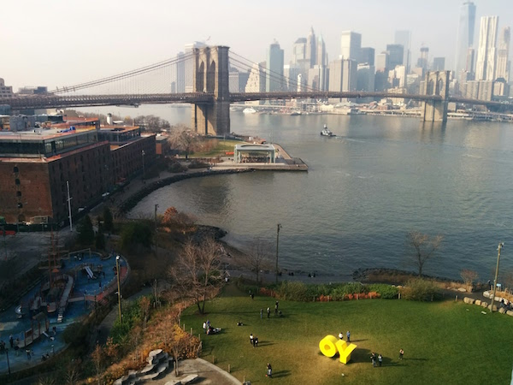

Blurring
https://codewords.recurse.com/issues/six/image-processing-101
Notes:
demo: transform.html

Slide 20
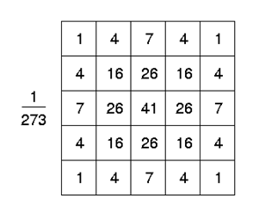
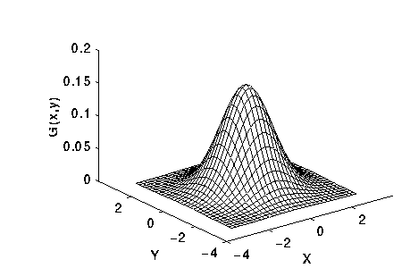
Blurring
5x5 Gaussian blur
# gaussian blur
img = cv2.GaussianBlur(src, (5, 5), 0)
https://codewords.recurse.com/issues/six/image-processing-101
Notes:
demo: transform.html

Slide 21
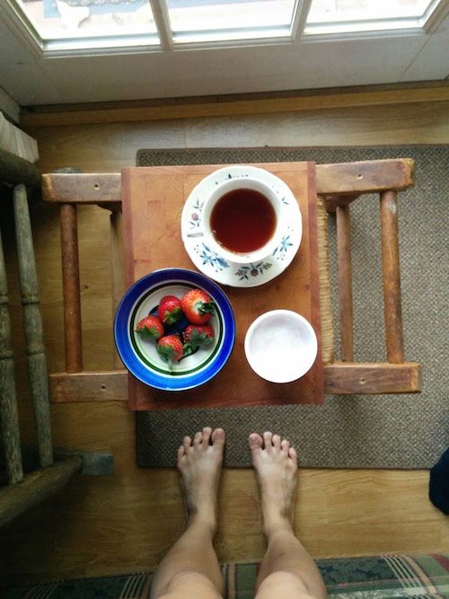
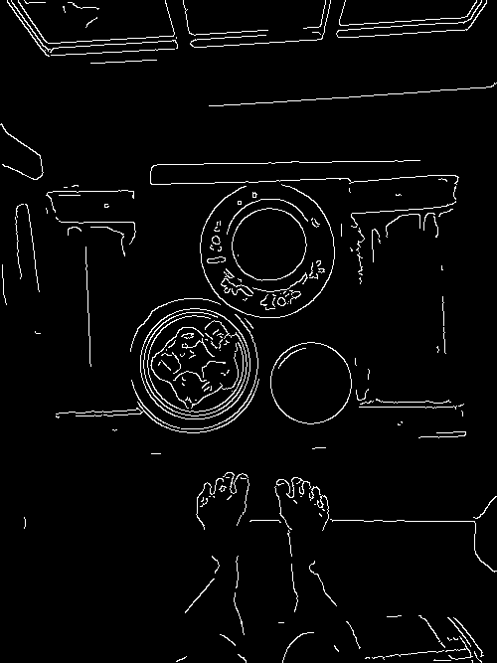
边缘检测 - Edge detection
https://codewords.recurse.com/issues/six/image-processing-101
Notes:
demo: transform.html

Slide 22
边缘检测 - Edge detection
Canny edge detection algorithm
# preprocess by blurring and grayscale
img = cv2.GaussianBlur(src, (7, 7), 0)
img = cv2.cvtColor(img, cv2.COLOR_BGR2GRAY)
# find binary image with edges
img_canny = cv2.Canny(img, threshold1=90, threshold2=110)
https://codewords.recurse.com/issues/six/image-processing-101
Notes:
demo: transform.html

Slide 23
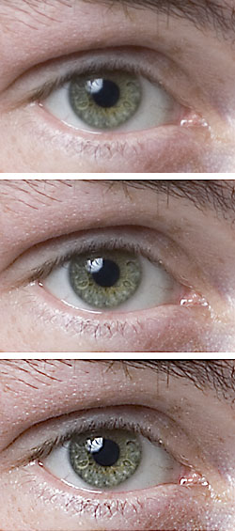
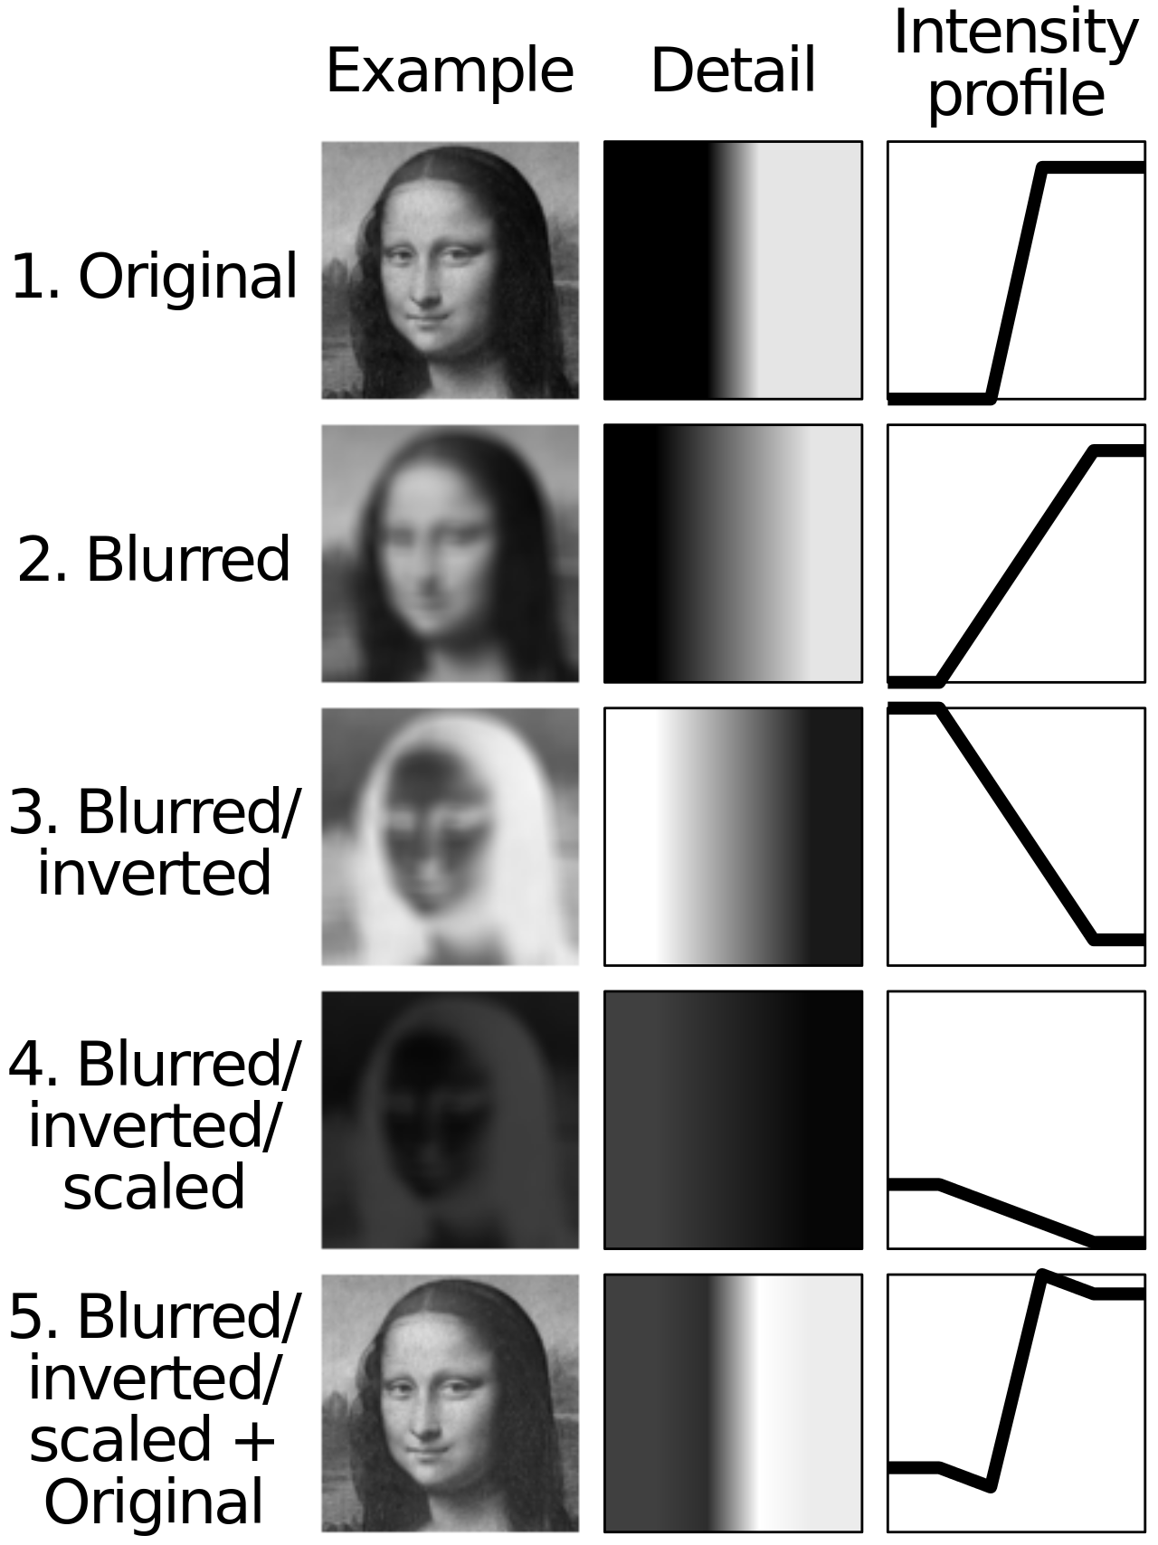
锐化
https://en.wikipedia.org/wiki/Unsharp_masking
Notes:
demo: transform.html

Slide 24
锐化 - unsharp
sharpened = original + (original − blurred) × amount.
# blur the image
img_blur = cv2.GaussianBlur(img, (7, 7), 0)
# apply unsharp masking
img = cv2.addWeighted(img, 2, img_blur, -1, 0)
https://theailearner.com/tag/cv2-addweighted/
Notes:
demo: transform.html

Slide 25
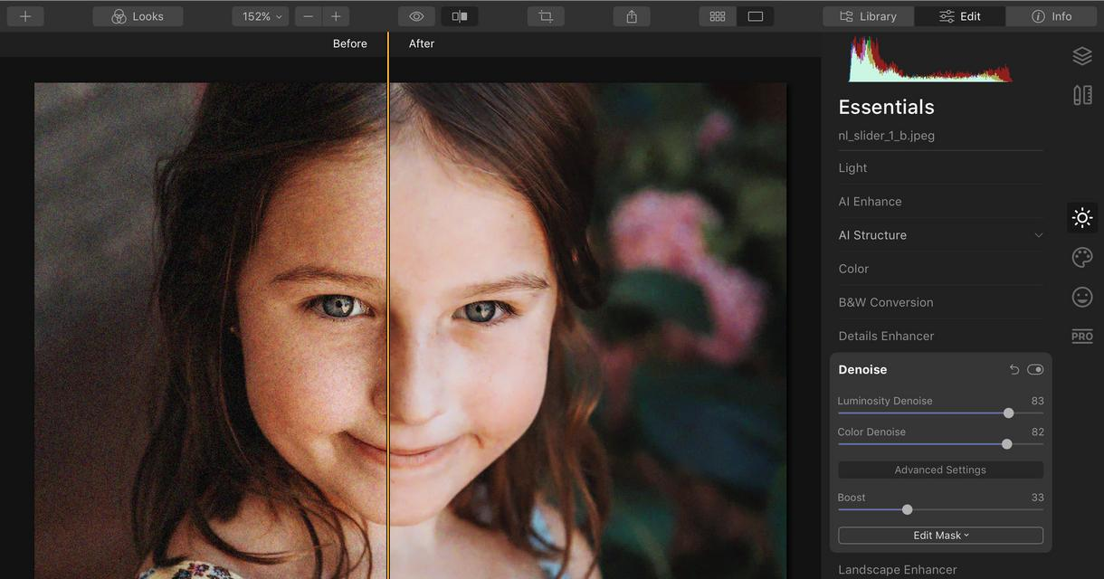
时域降噪
Notes:
demo: transform.html

Slide 26
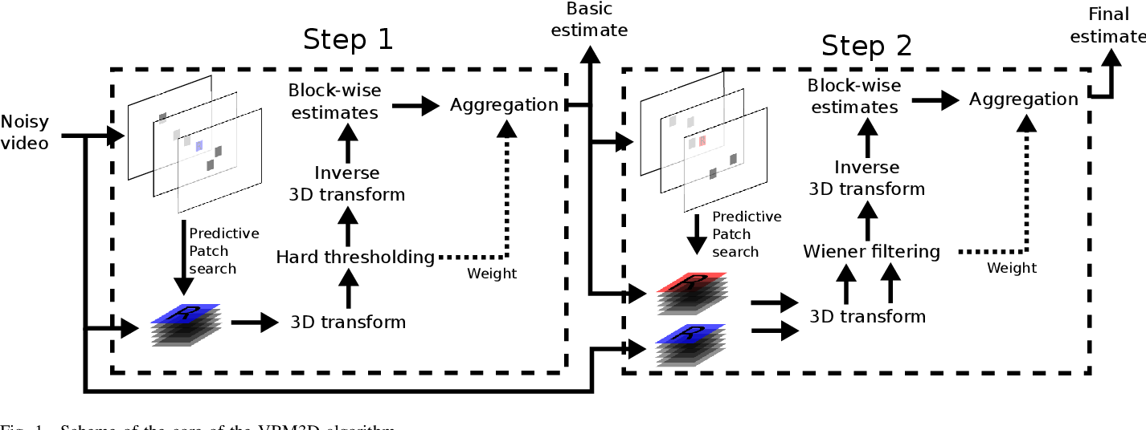
时域降噪
VBM3D
Block Matching + 3D transform
Notes:
demo: transform.html

Slide 27
Video Processing in RTC
Video Analysis
场景识别
人像分割
质量评估
Video Processing
视频降噪
色彩增强
超分辩率
倍帧
Notes:
demo: transform.html

Slide 28
视频标准及编解码

Slide 29
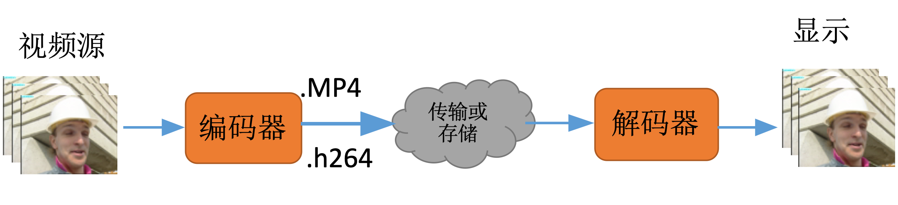
What is Video Coding / Compression?
压缩原始视频
Encoder + Decoder = Codec
有损与无损压缩
Notes:
demo: transform.html

Slide 30
Why using Video Coding?
原始视频数据量大：
如果以RGB格式存储，720p视频, 帧率25，每秒数据量：
8* 3 * 720 * 1080 * 25 = 55 MB/s
编码后，码率一般在400kB/s 以内
思科报告：2016 年, 互联网73% 的流量是视频流量。预计到2021年，这个数字会增长到 82% 。
Notes:
demo: transform.html

Slide 31
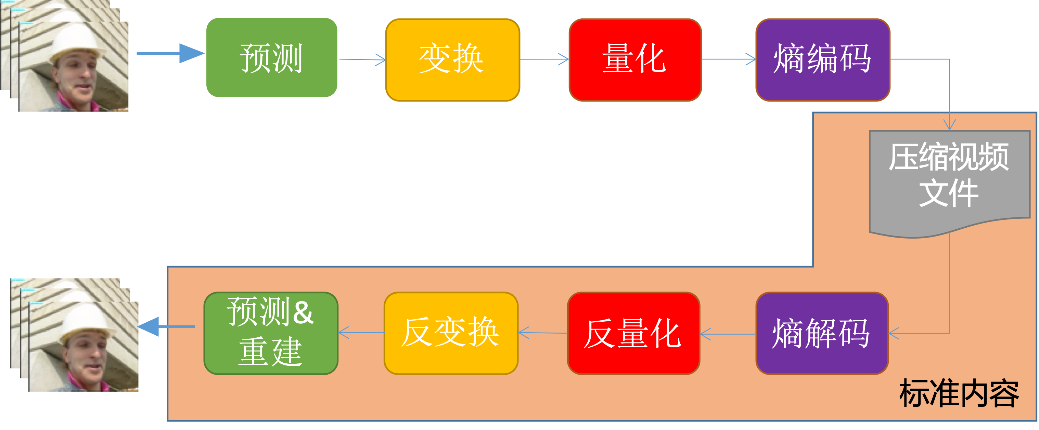
What is Video Compression Standard?
Notes:
demo: transform.html

Slide 32
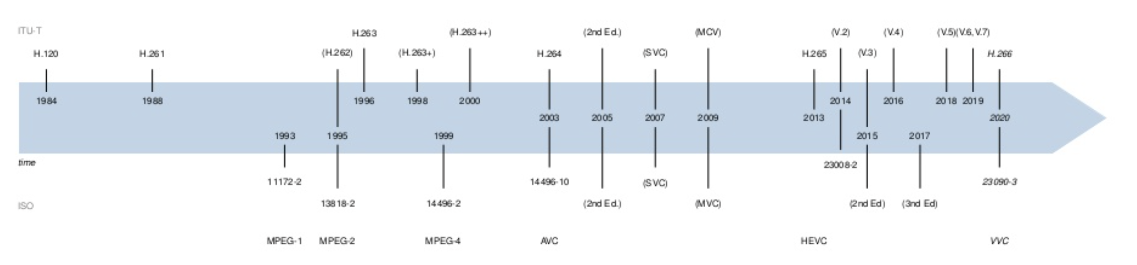
History of Video Coding Standards
ISO / IEC MPEG: Moving Picture Experts Group (MPEGx)
ITU-T VCEG: Video Coding Experts Group (H.26x)
JVT: Joint Video Team (H.264)
Notes:
demo: transform.html

Slide 33
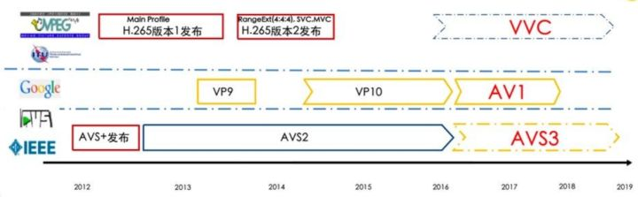
History of Video Coding Standards
Alliance for Open Media (Google)
Audio Video Coding Standard (AVS)
Notes:
demo: transform.html

Slide 34
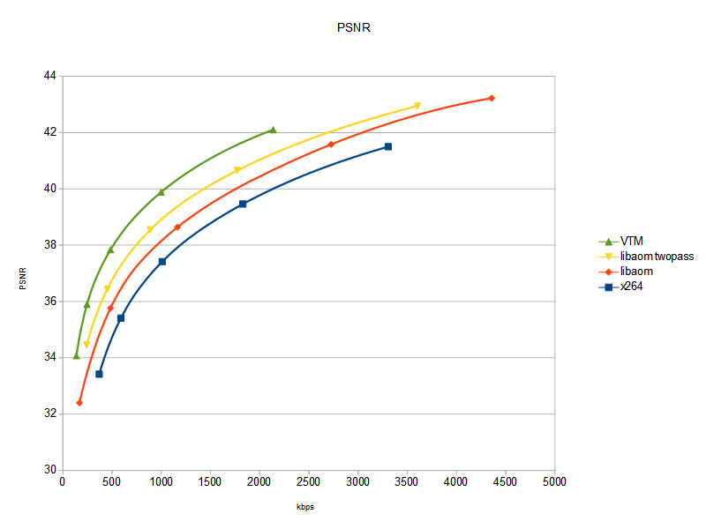
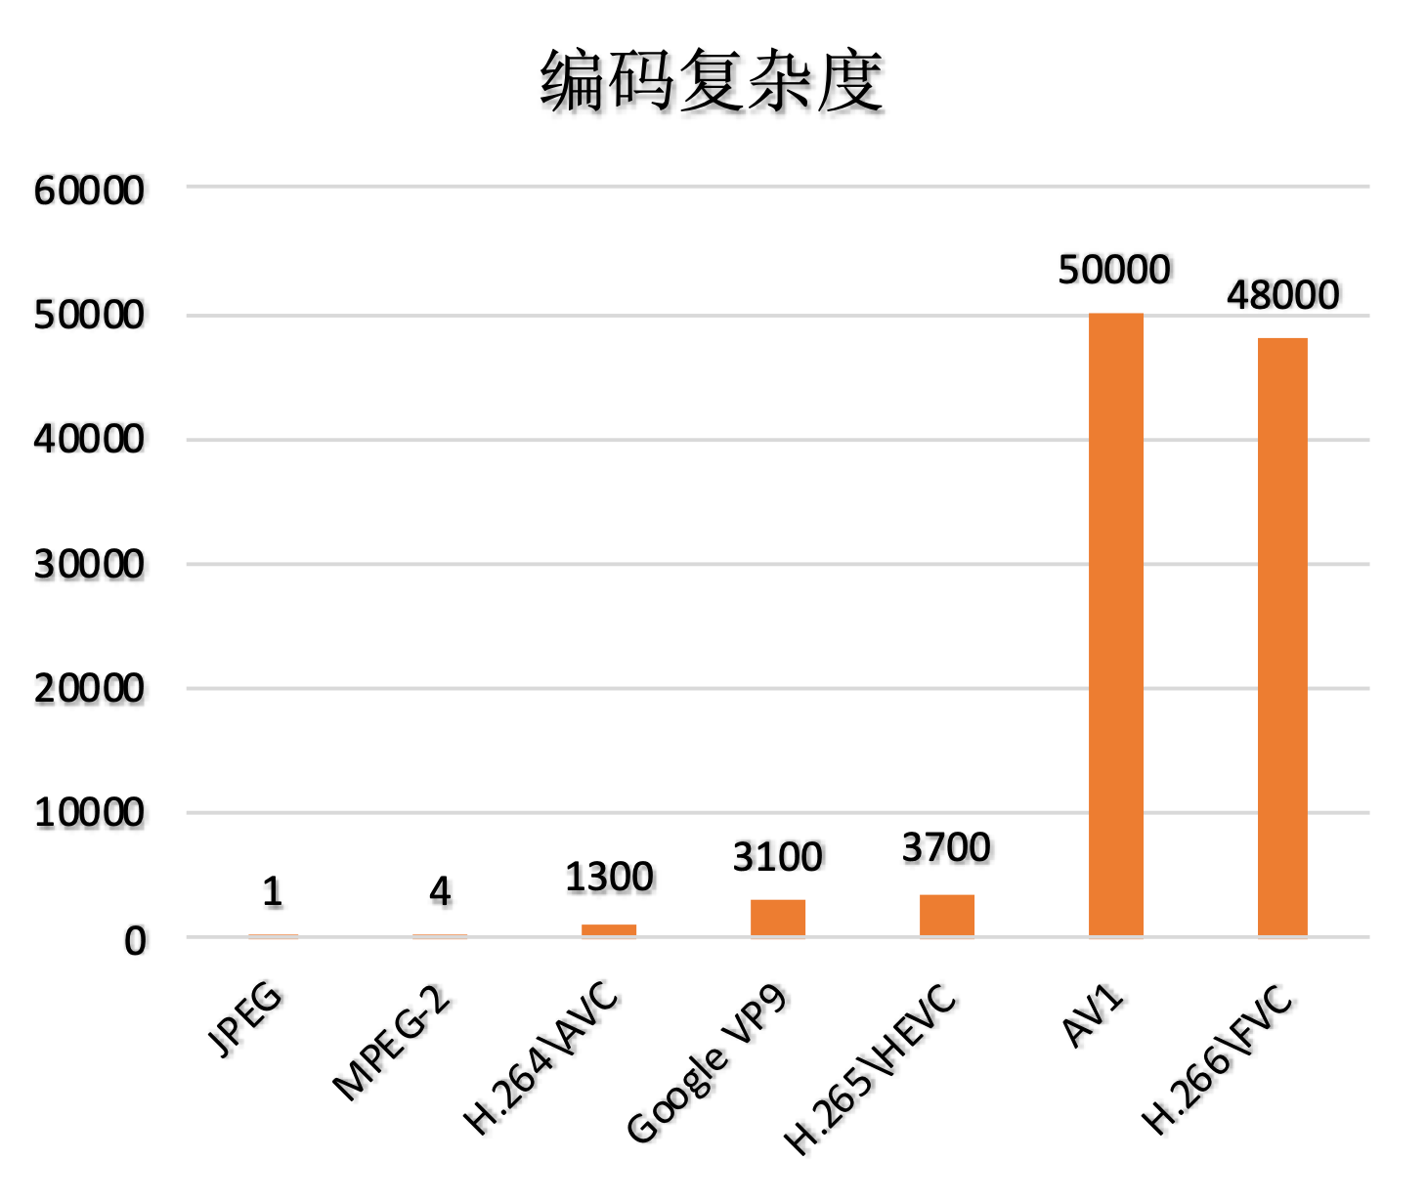
How to Compare a Video Encoder?
Rate-Distortion
Complexity
MSU video codecs comparison (https://www.compression.ru/video/codec_comparison/codec_comparison_en.html)
Notes:
弱类型

Slide 35
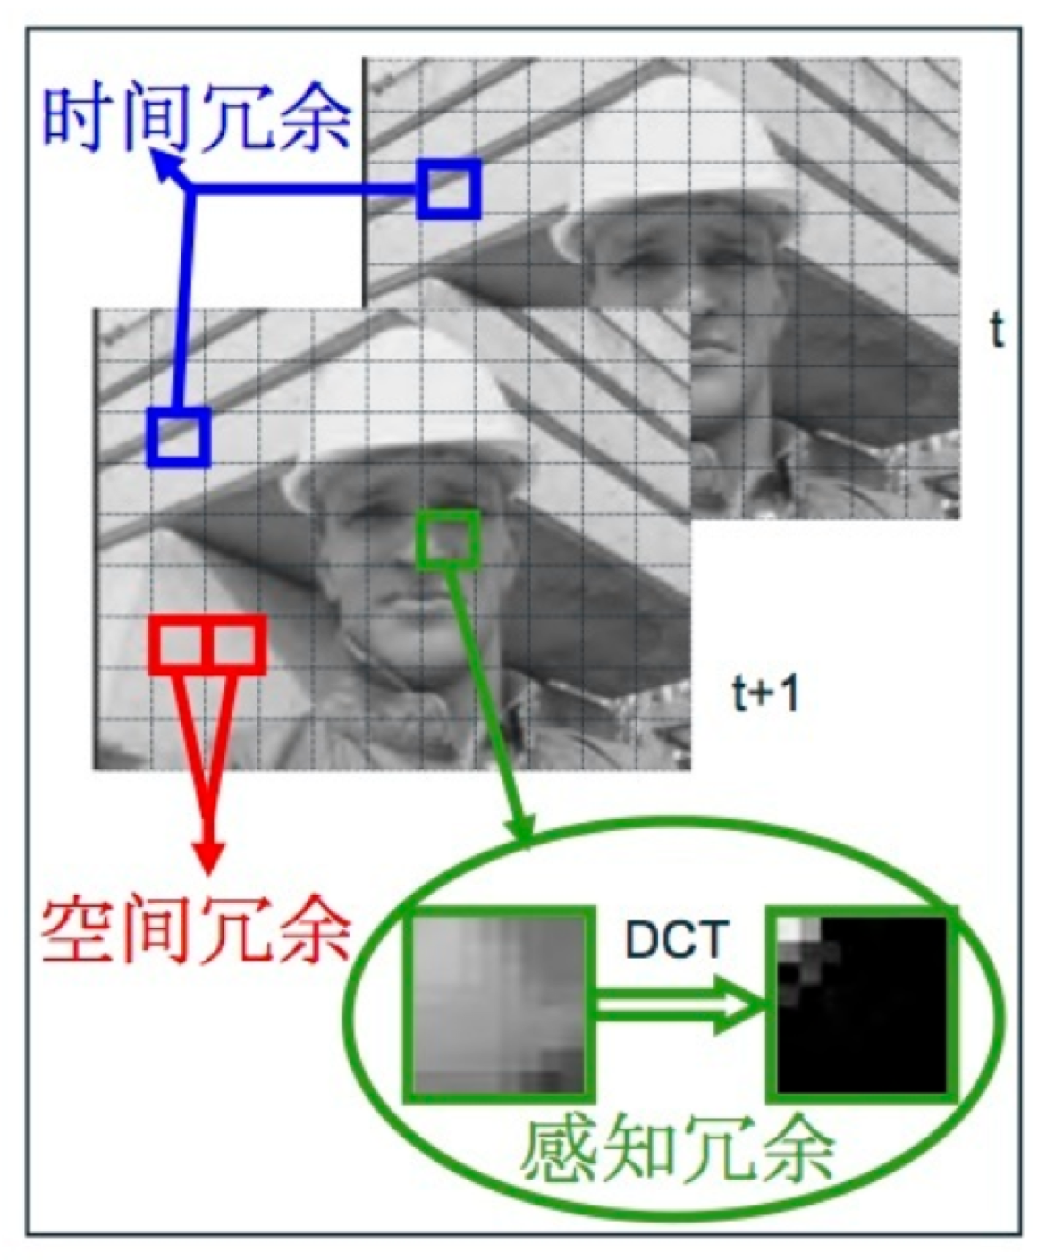
Coding Principle
Prediction
Intra prediction：消除空域冗余
Inter prediction：消除时域冗余
Transform & Quantization：消除感知冗余 (lossy)
Entropy Coding：进一步消除冗余信息
Notes:
弱类型

Slide 36
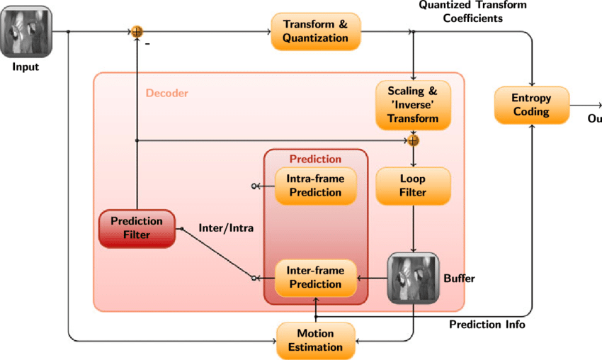
Hybrid Video Coding Structure
Motion compensated prediction + transform
Since H.261, 1988
Notes:
弱类型

Slide 37
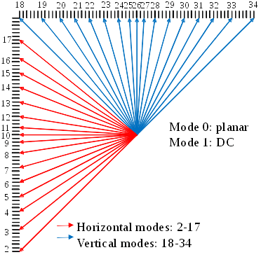
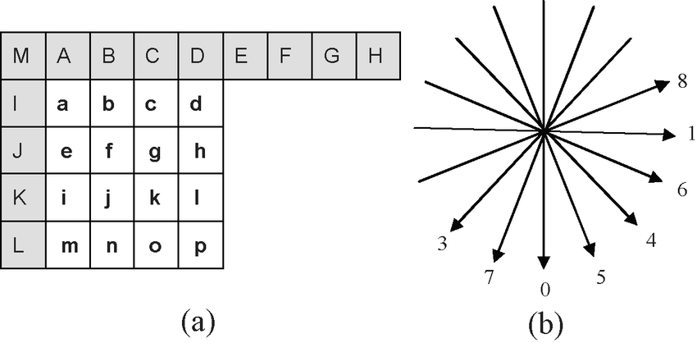
Coding Principle - Intra Prediction
H.264
H.265
Notes:
弱类型

Slide 38
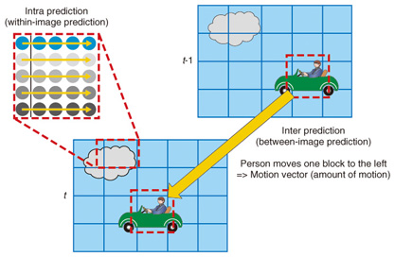
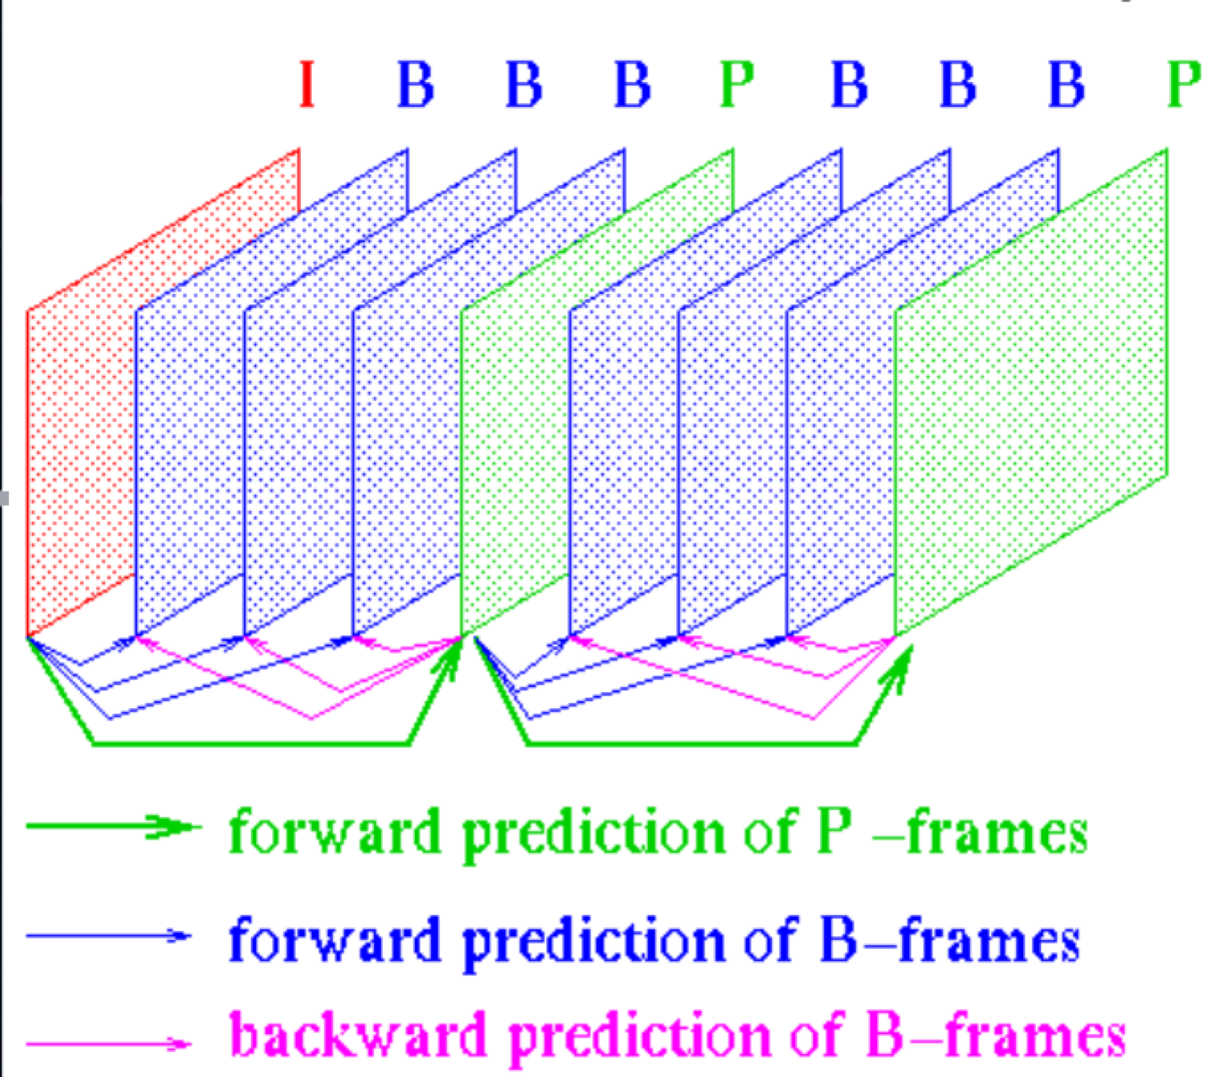
Coding Principle - Inter Prediction
Motion Estimation
Reference Structure
Notes:
弱类型

Slide 39
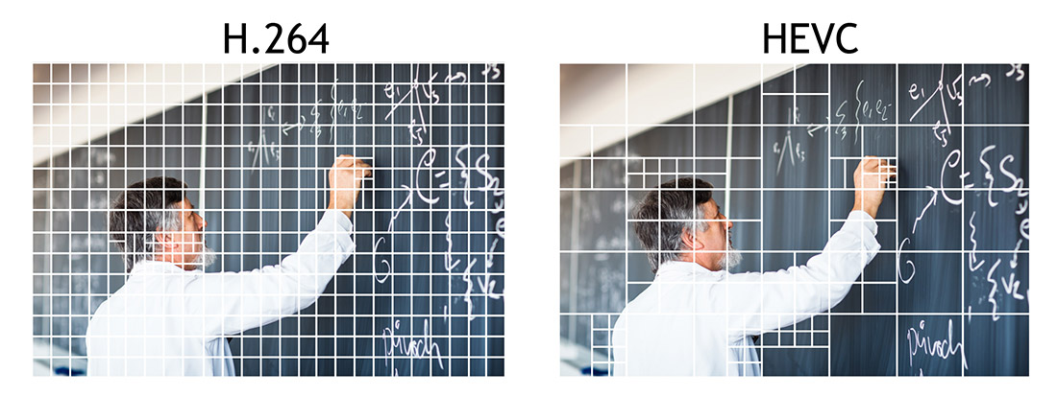
Coding Principle - Partition
We Need To Go Deeper
Notes:
弱类型

Slide 40
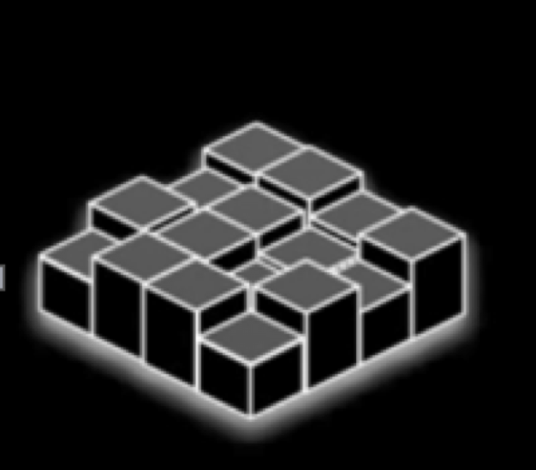

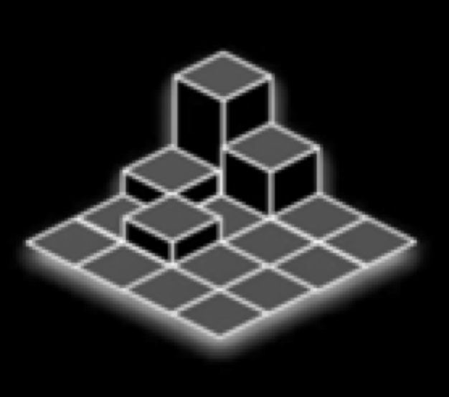
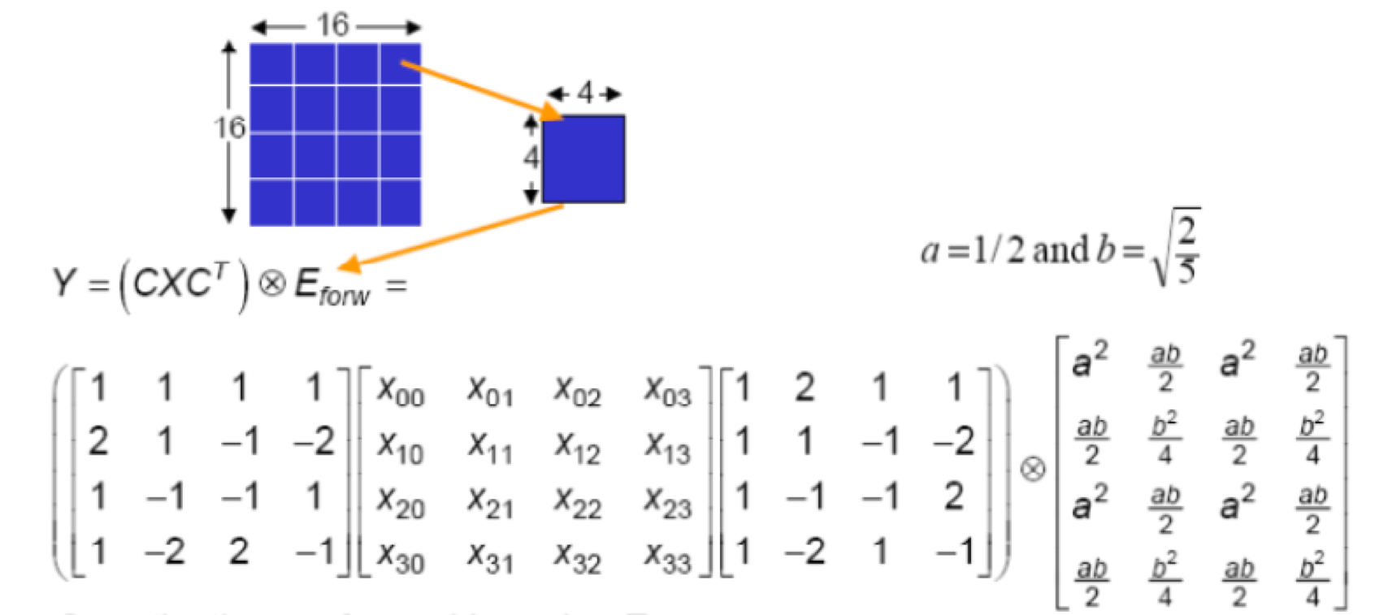
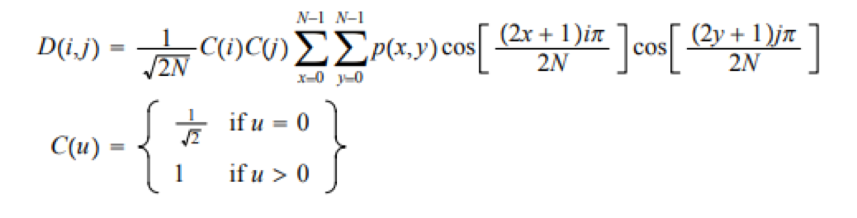
Coding Principle - Transform & Quantization
DCT Transform
Quantization
Notes:
弱类型

Slide 41
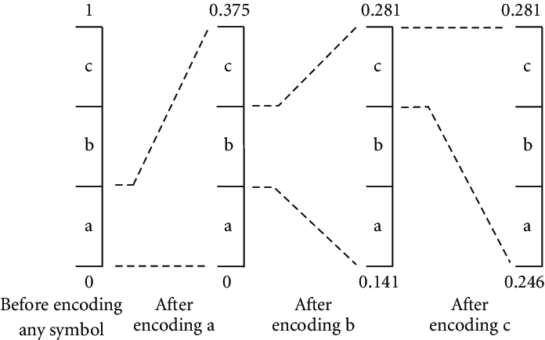
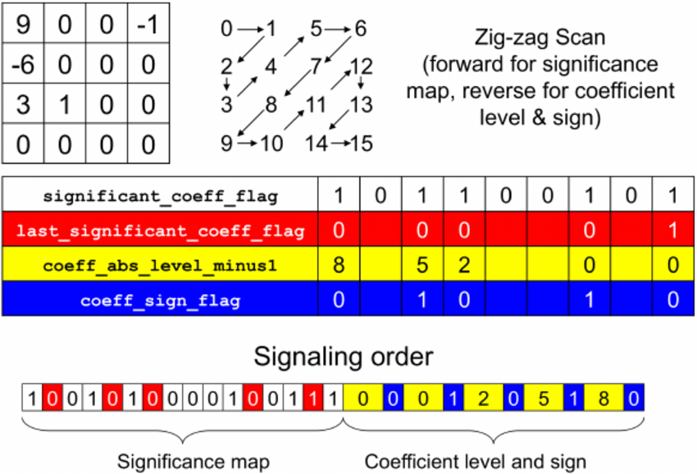
Coding Principle - Entropy Coding
CABAC (Context Adaptive Binary Arithmetic Coding)
Arithmetic Coding
CABAC
Notes:
弱类型

Slide 42
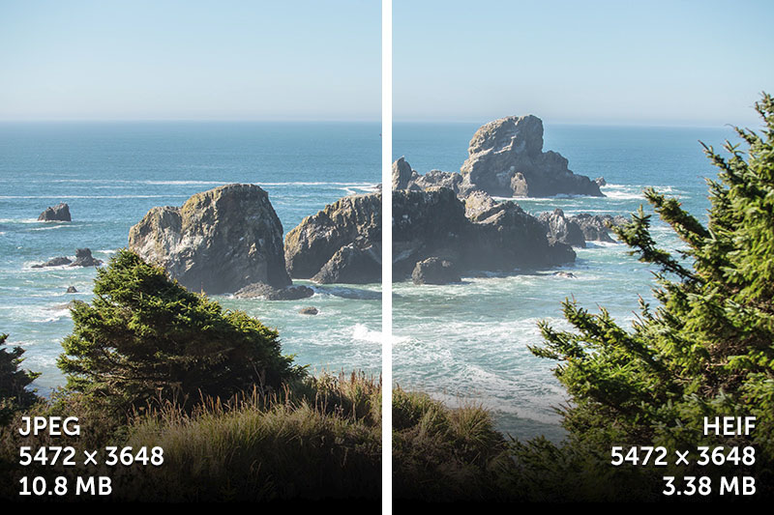
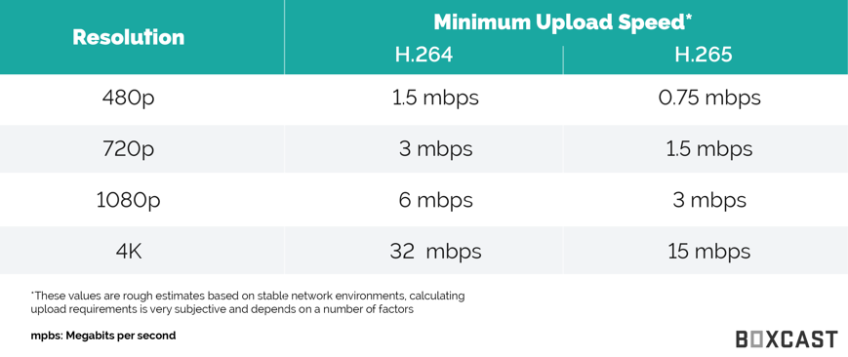
Video Coding - Wrap Up
Notes:
弱类型

Slide 43
Reference
Image Processing 101
Google
Notes:
弱类型

Slide 44
Q & A

Slide 45

THANKS.

